Slide 1
District Attendance Supervisor Information and Certification
Santa Clara County Office of Education
Safe and Healthy Schools Department
Jennifer Del Bono, Director
669-292-1261

Slide 2
Safety Announcement
In the event of an emergency evacuation:
Please notify me if you require assistance exiting
Follow me as we vacate the room and building
Proceed to the parking lot evacuation area for roll call
Do not leave until attendance reporting is completed
We greatly appreciate your cooperation in the event of an emergency

Slide 3
Santa Clara County Office of Education
Santa Clara County Office of Education (SCCOE) is a state regional service agency that provides:
instructional, business, and technology services to the 31 school districts of Santa Clara County;
directly serves students through special education programs, alternative schools, Head Start and State Preschool programs, migrant education, and Opportunity Youth Academy;
provides academic and fiscal oversight and monitoring to school districts and the 22 county board authorized charter schools;
provides essential services and technical assistance throughout the region and statewide.

Slide 4
Education Code 48240
The governing board of each school district and each county superintendent of schools shall appoint a supervisor of attendance…

Slide 5
Education Code 48240
The governing board of the school district or county superintendent of schools shall prescribe the duties of the supervisor of attendance.

Slide 6
Education Code 48245
In districts with over 1000 students the supervisor of attendance must be certificated by the county board of education.

Slide 7
Under Assembly Bill 2815, which became law on January 1, 2017, the role of attendance supervisors has been expanded to include more effective practices to address chronic absenteeism and truancy.
Reducing California’s high chronic absenteeism rates is a priority in the Local Control and Accountability Plan (LCAP). This update to California Education Code (EC) sections 48240–48244 can be a tool for meeting local goals to reduce chronic absenteeism rates. These changes in attendance supervision practices help promote a culture of attendance and improve local systems to accurately track pupil attendance by grade level and pupil subgroup.

Slide 8
Attendance Leadership Responsibilities

Slide 9
Expanded Duties of Attendance Supervisors…
Raise the awareness of school personnel, parents, guardians, caregivers, community partners, and local businesses of the effects of chronic absenteeism, truancy, and other challenges associated with poor attendance.
Identify and respond to grade level or pupil subgroup patterns of chronic absenteeism or truancy.
Identify and address factors contributing to chronic absenteeism and habitual truancy, including suspension and expulsion.
Ensure that pupils with attendance problems are identified as early as possible to provide applicable support services and interventions.
Evaluate the effectiveness of strategies implemented to reduce chronic absenteeism rates and truancy rates.

Slide 10
Expanded Duties of Attendance Supervisors Continued…
Effective January 1, 2019, supervisors of attendance have a duty to ensure that students receiving individual instruction in home and hospital programs are excused from the regular school program until they return to their regular school program.

Slide 11
A Shift In Our Focus
2019-2020
From Truancy to Chronic Absenteeism by Creating Compassion-Informed Response Through An MTSS Framework

Slide 12
It’s A Paradigm Shift!
Definition:
a fundamental
change in approach
or underlying
assumptions.

Slide 14
We Offer Support

Slide 15
Santa Clara County Total
Santa Clara County | 9.0%
Statewide | 11.1%

Slide 16
The Data Appears Positive, but
This is your call to action for

Slide 17
Chronic Absenteeism By Ethnicity
Ethnicity | Cumulative Enrollment | Chronic Absenteeism Eligible Enrollment | Chronic Absenteeism Count | Chronic Absenteeism Rate 2016-2017 | Chronic Absenteeism Rate 2017-2018
African American | 5,483 | 5,306 | 706 | 12.0% | 13.3%
American Indian or Alaska Native | 916 | 901 | 155 | 14.8% | 17.2%
Asian | 83,473 | 82,680 | 2,599 | 2.8% | 3.1%
Filipino | 11,324 | 11,226 | 646 | 5.0% | 5.8%
Hispanic or Latino | 109,103 | 107,238 | 16,052 | 14.1% | 15.0%
Pacific Islander | 1,353 | 1,319 | 204 | 13.5% | 15.5%
White | 54,533 | 53,840 | 3,765 | 6.9% | 7.0%
Two or More Races | 13,302 | 13,151 | 794 | 5.6% | 6.0%
Not Reported | 2,060 | 1,993 | 190 | 10.1% | 9.5%
CDE Dataquest K-12

Slide 18
Chronic AbsenteeismBy Subgroup, 2017-2018
Subgroup | Cumulative Enrollment | Chronic Absenteeism Eligible Enrollment | Chronic Absenteeism Count | Chronic Absenteeism Rate
English Learners | 66,321 | 65,181 | 7,479 | 11.5%
Foster Youth | 1,125 | 1,004 | 406 | 40.4%
McKenney-Vento | 3,673 | 3,471 | 1,320 | 38.0%
Migrant Education | 1,154 | 1,141 | 165 | 14.5%
Socioeconomically Disadvantaged | 116,658 | 114,842 | 16,749 | 14.6%
Students with Disabilities | 31,702 | 30,912 | 5,560 | 18.0%

Slide 19
Factors That Contribute to Chronic Absenteeism
Barriers
Negative School Experiences
Disengaged
Misconceptions
*Illness, acute and chronic
*Lack of health, mental, vision, or dental care *Trauma
Unsafe path to school *Family responsibilities *Transportation *Frequent moves or school changes
*Involvement in child welfare or juvenile justice
*Struggling academically or socially
*Bullying (perceived or actual)
*Suspensions and expulsions
*Negative attitudes towards school
*Undiagnosed disability
*Cultural proficiency
* No meaningful relationships with adults at school
*No meaningful relationships with peers at school
*Do not feel welcome
*Few credits
*Absences are only a problem if unexcused
*Missing just 2 days per month doesn’t affect learning
*Sporadic absences aren’t a problem
*Attendance only matters in the upper grades

Slide 20
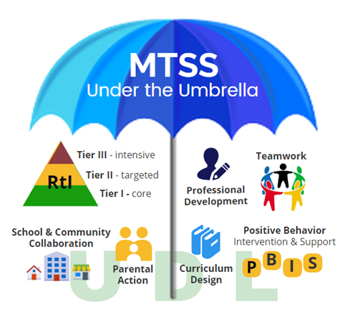
A Multi-Tiered System of Support

Slide 21
Building Core Strategies to Intensive
Tier 1 Strategies: To Address Needs of Students
Identify barriers to attendance that may require systemic schoolwide strategies instead of case management.
A conference between school personnel, the pupil’s parent or guardian, and the pupil.
Promoting co-curricular and extracurricular activities that increase pupil connectedness to school, such as tutoring, mentoring, the arts, service learning, or athletics.
Recognizing and rewarding pupils who achieve excellent attendance or demonstrate significant improvement in attendance.
Input and track data for chronic absenteeism
Establish attendance data teams or align with existing teaming structures to address attendance

Slide 22
Tier 2 Strategies: Interventions
Referral to a school nurse, school counselor, school psychologist, school social worker, and other pupil support personnel for case management and counseling.
Collaboration with child welfare services, law enforcement, courts, public health care agencies, or government agencies, or medical, mental health, and oral health care providers to receive necessary services.
Collaborating with school study teams, guidance teams, school attendance review teams, or other intervention-related teams to assess the attendance or behavior problem in partnership with the pupil and his or her parents, guardians, or caregivers.
Tier 3 Strategies: District-wide Teams and Supports
Referral to a School Attendance Review Board.
Referral to a county truancy mediation program.

Slide 23
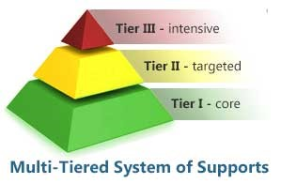
The last resort…
District Attorney Referral

Slide 24
Support Available
Contact LCAP Advisory or Differentiated Assistance team to schedule a planning/consulting session as they’re here to be your thought partners.
Contact the Safe and Healthy Schools team for PBIS/Foster Youth and McKenney-Vento Advocacy/TUPE
CDE State Handbook
Attendance Works
Join the Safe and Healthy Schools Network meetings (3/28, 4/ 18)
Register for the 5th Annual PBIS/Positive School Climate Symposium w/David Kopperud | dkopperud@cde.ca.gov | 916-323-1028
District Attendance Supervisor Certification training, August.

Slide 25
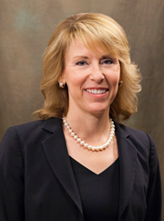
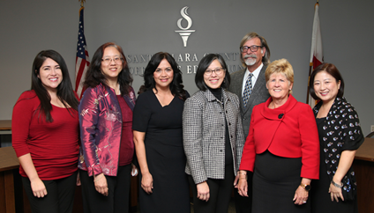
Leadership, Service, & Advocacy
County Superintendent
County Board of Education
Dr. Mary Ann Dewan
Darcie Green, Area 6; Grace Mah, Area 1; Claudia Rossi, Area 7; Rosemary Kamei, Area 3; Joseph Di Salvo, Area 4; Kathleen King, Area 2; Anna Song, Area 5

Slide 26
Connect with SCCOE
Social Media
Ed Bulletin (e-newsletter)
www.sccoe.org

